Slide 1



User Guide: i-Sisen
Natural Gas Questionnaire

Slide 2
Topics:
- Access to the Natural Gas questionnaire
- Creating new Natural Gas questionnaire
- Questionnaire Details
- Model Details
- Edit Model g2im Gas Imports
- Edit Model g2im Gas Imports: Charge with the Add Record mode
- Edit Model g2im Gas Imports: Charge with the Upload Excel file mode
- Change in condition: Switch to VERIFIED
- Change in condition: Switch to VALIDATED
- Change in condition: Validation by the BackOffice of MiSE

Slide 3
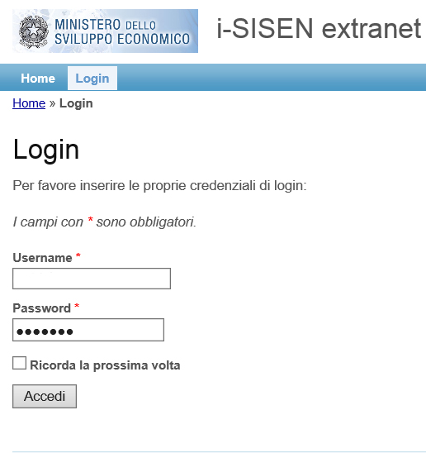
Login
On this page you can enter your username and password to access to the portal:
Username and Password will be sent by mail to the contact person.
Flag “Ricorda” allows the browser used by the user to store the username-password pair for subsequent accesses.

Slide 4
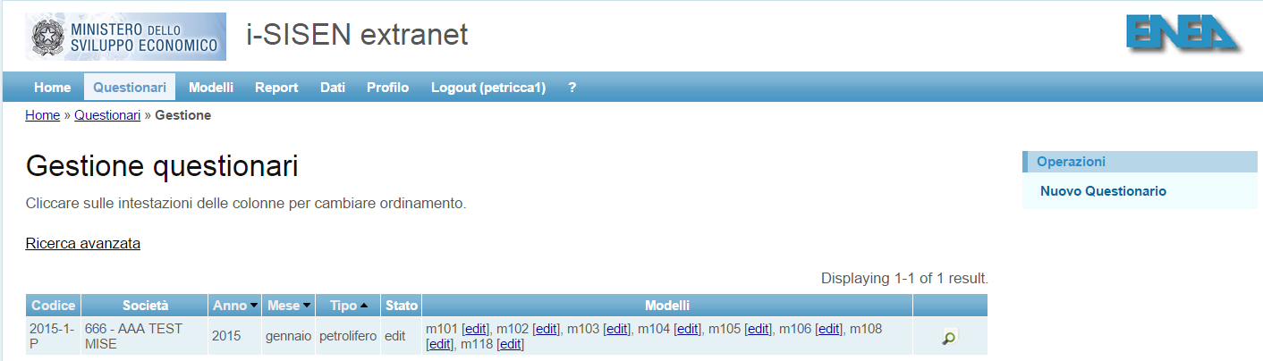
Access to the Natural Gas questionnaire
In the horizontal menu at the top of the page click on 'Questionnaires':
They will see all the questionnaires have already been created (in any state of validation).
In the menu 'Operations‘ (Operazioni) at the far right of the page click on 'New Questionnaire‘ (Nuovo Questionario):
This will open a new page with the form of creation of the new questionnaire.

Slide 5
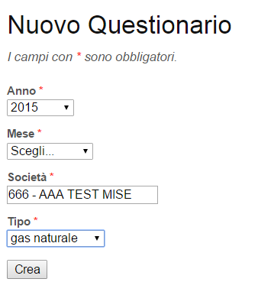
Creating new Natural Gas questionnaire
The form shown you the chance to choose the following fields:
Year (selectable) (Anno)
Month (selectable) (Mese)
Company (fixed) (Società)
Type (selectable) (Tipo)
For new companies the creation of the questionnaire should be conducted in agreement with the indications provided by the BackOffice of reference. For all others, the rule is to follow the sequence of communication (i.e. we create the questionnaire of the first month not yet announced).
Where the questionnaire will already created, system will return a message of error. You can enter the details of the questionnaire already created via the menu ‘Questionari' which contains the list of all questionnaires created.
The questionnaire of the Natural Gas has within it three distinct models:
G1ve, G2im, G3es (sales, imports and exports, respectively)
Each company will find qualified models only assigned by the BackOffice MiSE.

Slide 6
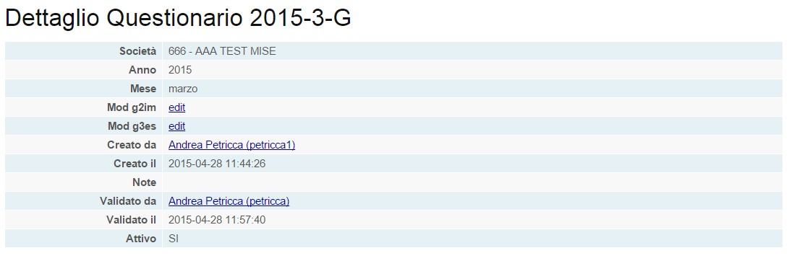
Questionnaire Details
In this example, at the 666-Test_Mise tests company was assigned exclusively models g2im and g3es.
The 'Questionnaire Details' (Dettaglio Questionario) displays the state of the models in the questionnaire of the Natural Gas.
By clicking the 'edit' button on the model for which you want to enter data, you will enter a screen 'Details Model' (Dettaglio Modello) that will allow the operator to enter the reference values.
NB. The slides that follow will view that the data for the model g2im. Same input mode should be used if the Company was also assigned models g1ve g3es and the same questionnaire.

Slide 7
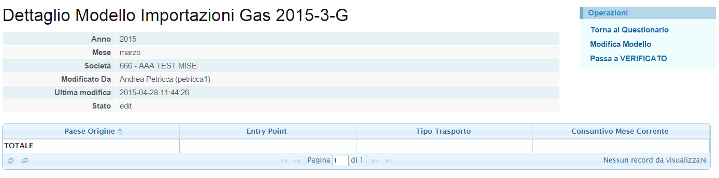
Model Details
In 'Details Model‘ (Dettaglio Modello) of G2im will be possible via the menu on the right of the page OPERATIONS (Operazioni):
- Go back to the questionnaire of the Natural Gas
- Enter the G2im model data ‘Change Model’ (Modifica Modello)
- Perform the first steps of the state (in Step VERIFIED) of the model

Slide 8
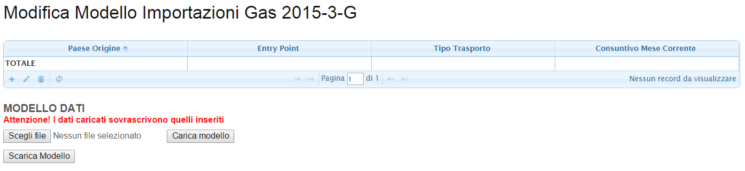
Edit Model g2im Gas Imports
By clicking on ‘Model Change’ button (Modifica Modello) in the Operations menu, you have the ability to edit the model using two modes:
- Via the Add Record (i.e. by inserting the values of only the reference cells of the selected row)
- By uploading an Excel file filled earlier with the values of interest

Slide 9

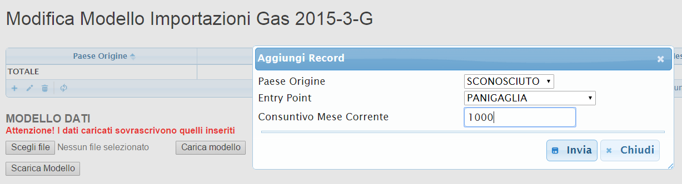
Edit Model g2im Gas Imports: Charge with the Add Record mode
Click with the left mouse button on the symbol '+' opens the input mask ‘Add Record’
After entering the data of the survey, you can click on the 'Send' button (Invia) to confirm the value.
This procedure is repeated for all lines relating to different imports that occurred in the month of the survey.

Slide 10
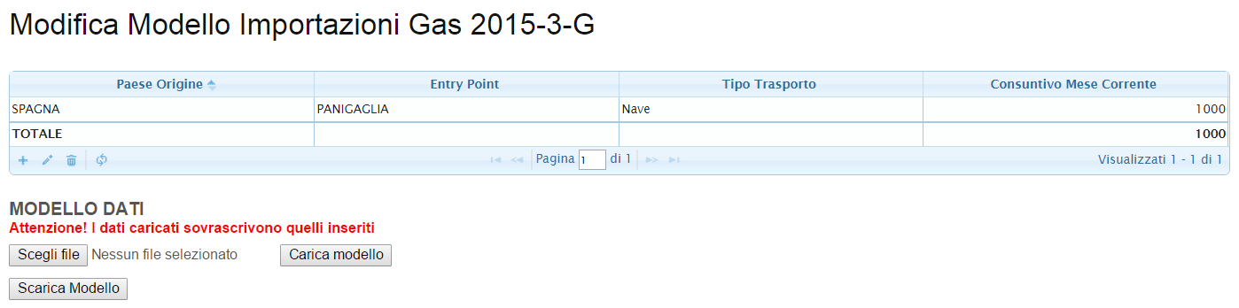
Edit Model g2im Gas Imports: Charge with the Add Record mode (2)
The data will be displayed in the table on the ‘Model Change’ page.
The user, in the presence of an input error, can proceed to change the line:
- clicking on the same line with the left mouse button to select it
- clicking on the 'pencil' on the right side of the button '+ Add Record'.
- It will reopen the input screen for the appropriate corrections.
The same procedure if you want to completely eliminate the inserted row. The key to be used is indicated with the 'bin'.

Slide 11
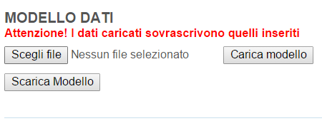
Edit Model g2im Gas Imports: Charge with the Upload Excel file mode
The system allows loading data by uploading an Excel file, too.
Using the button ‘Download Model’ (Scarica Modello) you can download the model of the company.
If in the model there are already data, in the Excel downloaded they appear. Otherwise, the template does not contain any data pre-loaded.
Once you have completed the model, just select it by pressing ‘Choose file’ (Scegli file), and then click ‘Load Model’ (Carica Modello).
NB. The data entered must meet the pre-defined fields, in the shape, location and structure.

Slide 12
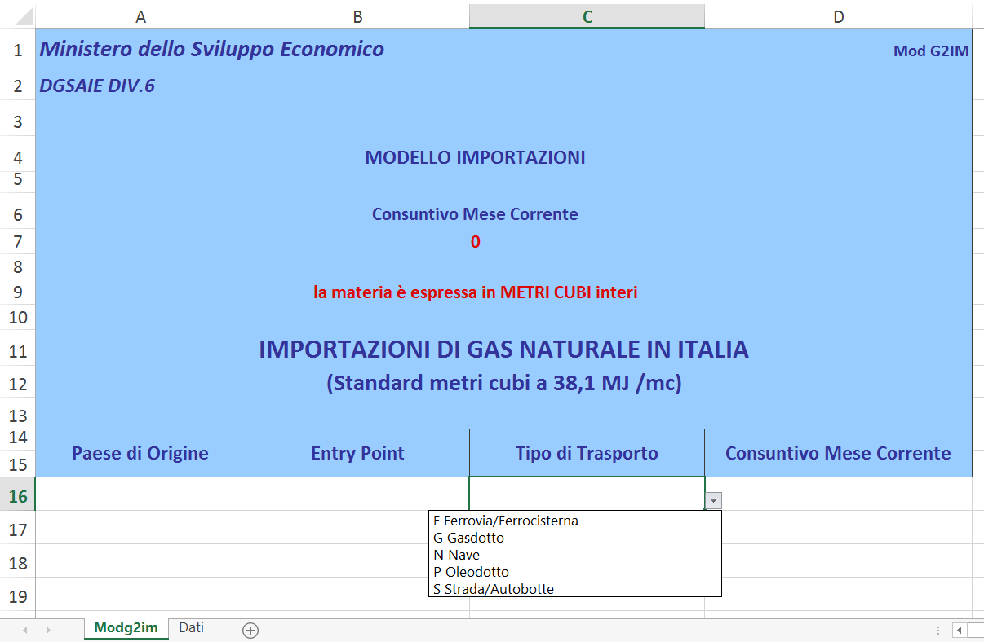
Edit Model g2im Gas Imports: Charge with the Upload Excel file mode (2)
In the figure, it is displayed the g2im Excel model of the Natural Gas questionnaire.
The user can enter a string using the pull-down menu and the field filled in by hand relative to the quantity of matter (expressed in full CUBIC METERS).
NB. The sheet ‘dati.xls’ will be contained within the model downloaded. You no longer need to download it separately.

Slide 13
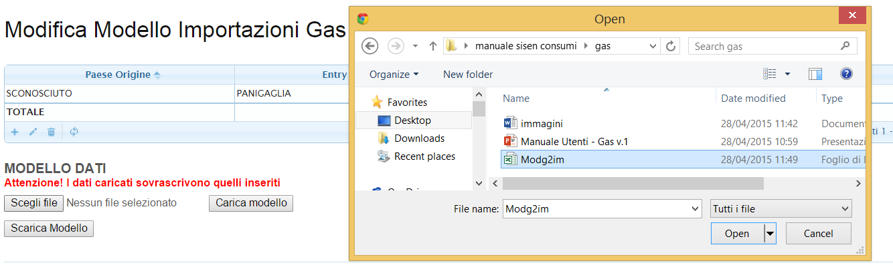
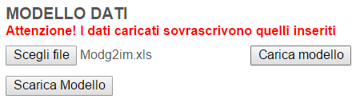
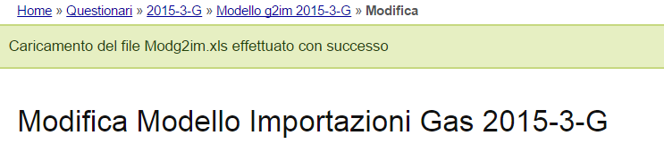
Edit Model g2im Gas Imports: Charge with the Upload Excel file mode (3)
By clicking on ‘Choose file’ (Scegli file) users will be able to select the Excel file within your computer.
The ‘model charge’ (Carica Modello) will ensure that the Excel file is processed.
If successful, the system will return a message has finished loading, and the data will be saved. Otherwise an error is reported and the model will not change.

Slide 14
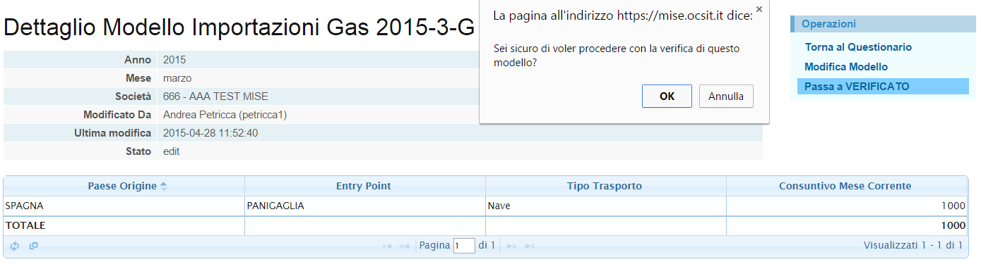
Change in condition: Switch to VERIFIED
After entering the data, you will need to return to the ‘Details Model’ page to switch the model in a state of VERIFIED.
Click on the ‘Skip to VERIFIED’ (Passa a VERIFICATO) to inform the BackOffice of MiSE that the data entered are, for now, correct and ready for Verification.
Until the VERIFIED state, the Company can independently bring in EDIT state the model if user notices an error in data entry.

Slide 15
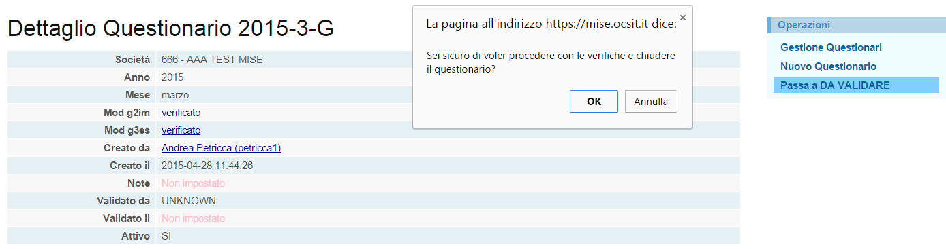
Change in condition: Switch to VALIDATED
For every model associated with the questionnaire, the user must request to switch the models in a VERIFIED state, otherwise it can not proceed with the request for validation of the questionnaire.
The user should return to the page ‘Questionnaire Detailed’ (Dettaglio Questionario) and proceed to change the questionnaire state by clicking on ‘Skip to VALIDATE’ (Passa a DA VALIDARE).
The system, again, ask the user if he wants to proceed with this operation.
NB. Before performing this step, we recommend that you review the data just entered.

Slide 16
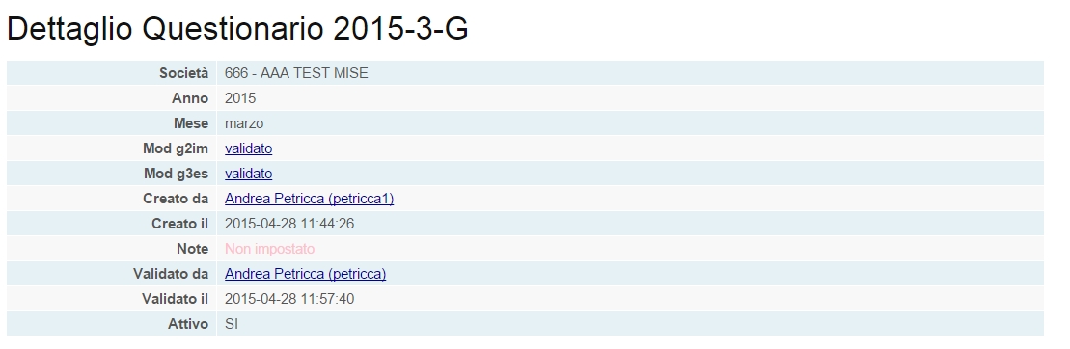
Change in condition: Validation by the BackOffice of MiSE
On the 'Questionnaire Details' (Dettaglio Questionario) you can see at any time the state of the questionnaire.
This information panel report also notes added by BackOffice during the process of data validation.
In the figure, the March 2015 Natural Gas questionnaire of the Company 666-Test-Mise is correctly entered and validated state by the BackOffice MiSE.
NB. After the change to VALIDATED state, users can no longer act on the data by application.

